Slide 1


Presentation about:
1. My learning experience on project1.
2. Presentation on Project2 : Data acquisition and data wrangling in python.
By : Isha Rawat

Slide 2


Sharing my experience and learning on project1 :
My aim with project1 was to understand basic python concepts like functions, loops and user input .
Learning and challenges faced :
Understanding basic syntax : learned about print(), input() and mathematical operators (+, _, *, /).
Handling user input: Used input() to take user numbers and operation choice.
Implementing functions: Created separate functions for addition, subtraction, multiplication, and division.
Error handling: Faced challenges with division by zero and non-numeric inputs.
Looping for multiple calculations: Implemented a loop to allow multiple calculations.

Slide 3
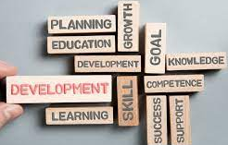
My learning:
Gained confidence in writing python code and debugging errors.
Learned the importance of handling exceptions.
Realized the importance of structuring the code with functions for better readability.
Key Features added :
Basic arithmetic operations (addition, subtraction, multiplication, division).
Input validation to prevent the errors.
Option to exit the program after completing calculations.

Slide 4
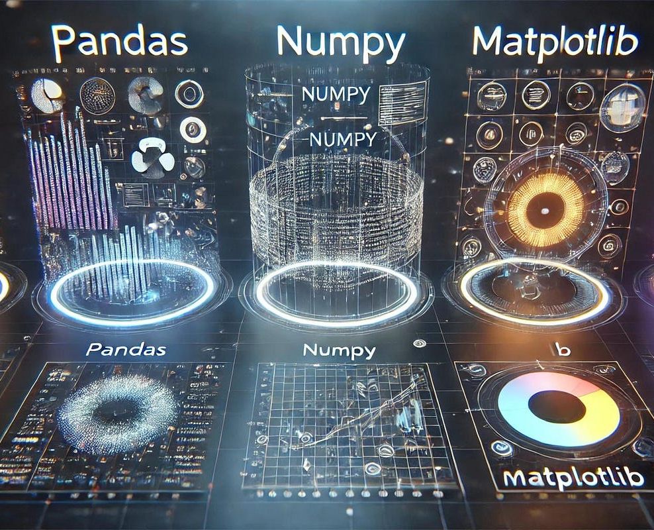
Introduction to project 2
Data acquisition and data wrangling in python.
Power of python libraries: Pandas, Numpy, Matplotlib

Slide 5

What is data acquisition:
Data acquisition refers to the process of collecting and importing data from various sources into a usable format for analysis. In python, data can be acquired from multiple sources.
The major sources of data:
Csv files : pandas.read_csv()
Excel files : pandas.read_excel()
Databases : using SQL server or sqlite3 and etc
APIs requests or beautifulsoup fro web scraping
JSON files L pandas.read_json()
Big Data sounrces : Hadoop, spark, etc

Slide 6

What is data wrangling ?
Data wrangling also known as data preprocessing or data cleaning. It is the process of transforming raw data into structured and usable format.
Data wrangling includes:
Handling missing values.
Removing duplicates.
Renaming columns.
Changing data types.
Handling Outliers
Feature engineering :
(creating new columns from existing data)
Data merging and joining data.

Slide 7
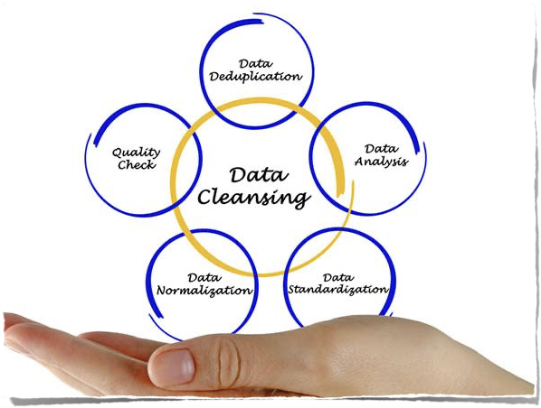
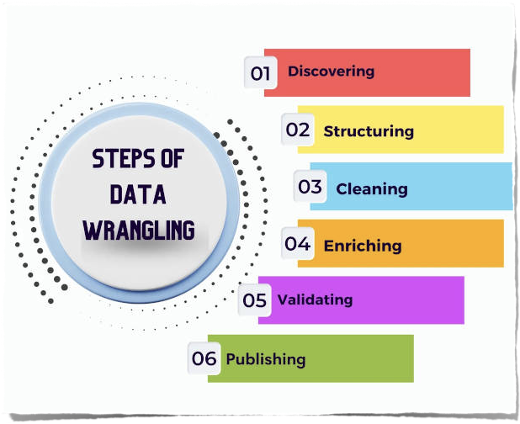
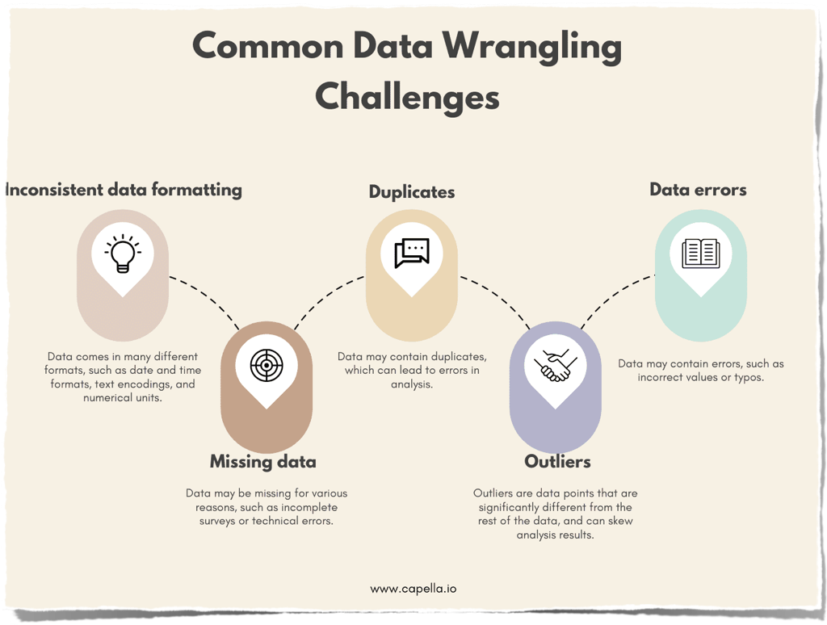
Important Steps and
Points to be considered
While Data cleaning
and common challenges
We face in data wrangling.

Slide 8
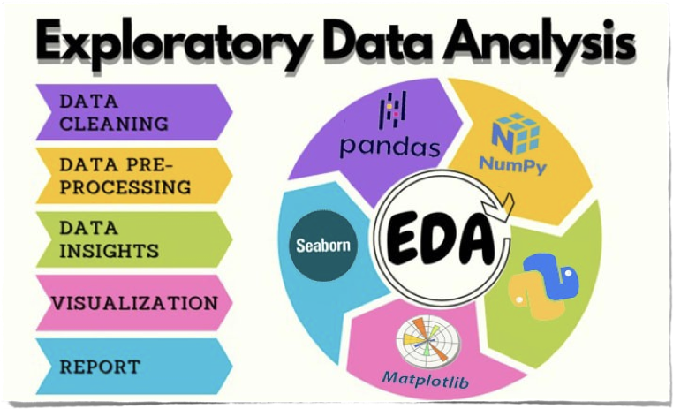
Exploratory Data Analysis (EDA) is an important part of Data Wrangling in Python. It helps in understanding and extracting insights by using statistical summaries and visualization to understand patterns and relationships.

Slide 9

Matplotlib vs Seaborn:
Both are python libraries widely used for data visualization.
Matplotlib provides a wide range of customizable 2D and 3D plots. Whereas Seaborn is particularly suited for visualizing complex datasets and statistical relationships.

Slide 10
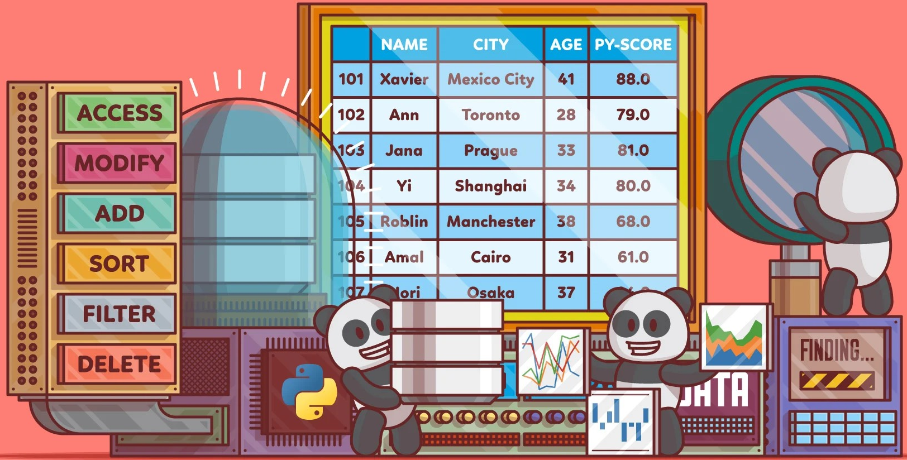
My learning from this project

Slide 11
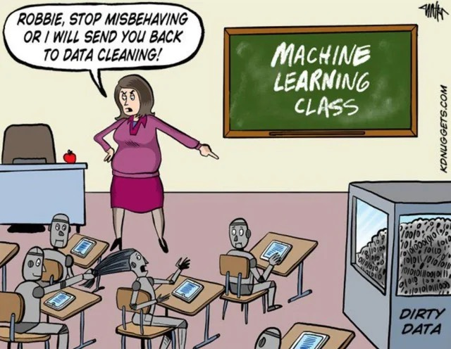
My learning outcome from this project:
Application of Data acquisition:
pd.read_csv(“data.csv”)
Different methods used for data wrangling:
Merge Datasets:
pd.merge()
pd.concat()
Identify unique values:
df.Value_counts()
df.unique()
df.nunnique()
Drop unnecessary columns:
df.drop(‘Column_name’, axis=1)
To be cont…

Slide 12
My learning outcome from this project:
Different methods used for data wrangling:
Check the dimensions of the dataset:
df.shape()
Check the datatype summary:
df.info()
Df.dtype
Treat missing values:
df.fillna()
Validate the correctness of the data:
df[‘column_name’].astype()

Slide 13

The capabilities of Pandas, NumPy, Seaborn, and Matplotlib in organizing, manipulating, and visualizing data have been essential for transforming raw data into valuable insights
Thank you for enhancing my data analysis journey!
By Isha Rawat

